Slide 1



address: banha
TEL: 42156815 , 01159057898
Notes:
NOTE:
To change the image on this slide, select the picture and delete it. Then click the Pictures icon in the placeholder to insert your own image.

Slide 2

Why the bookshop was named by this name ?
Behind every book is an idea and behind every idea is a step forward.

Slide 3
Introduction
-The main objective of the project is to manage the details of inventory , sales Of Fekra Library . - it manages all the information about books Such as Book Name and Author , Page Numbers ,Price And all Information about sales .

Slide 4
Our aim
this project offers an easy way to search about a particular book By many ways such as : The name of the book or the name of the author or the name of the category, It provides the possibility of additional new books .

Slide 5
contents
Form1:

Slide 6
start

Slide 7
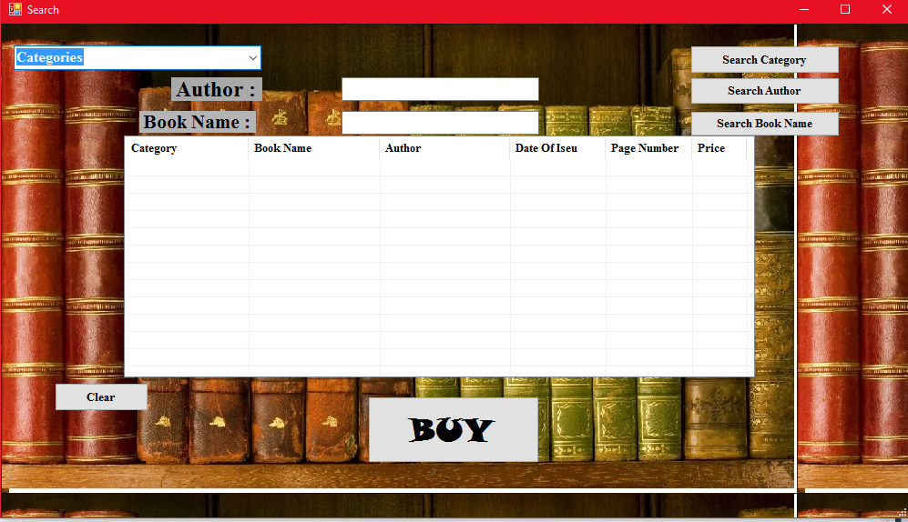
Start program Button
When We Click On Start Program Button, Move Us To Search Form .

Slide 8
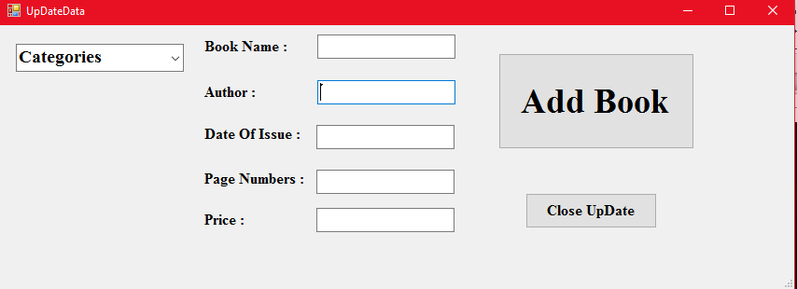
Update Button
When We Click On UpDate Button, Move Us To UpDate Data Form .

Slide 9
contents
Form2:

Slide 10
Search

Slide 11
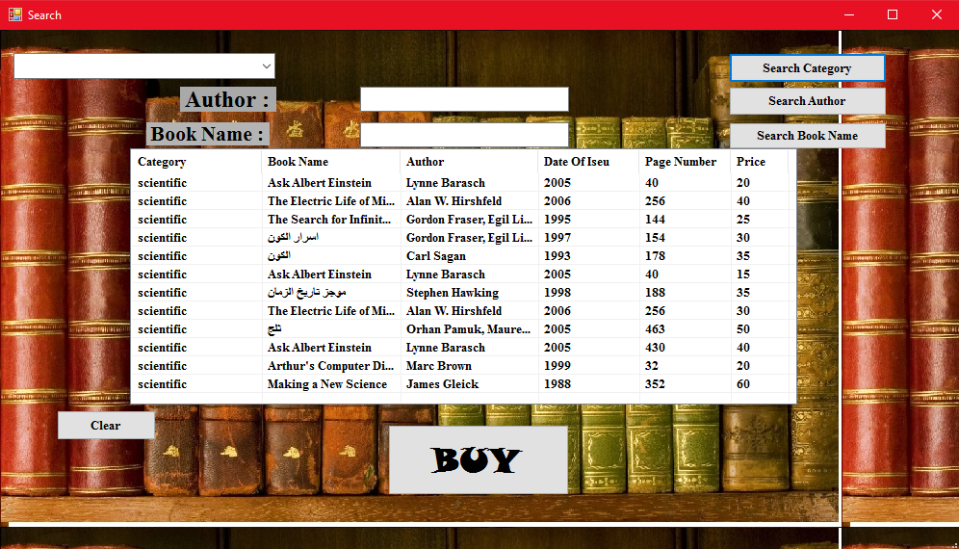
Search Category Button
When We Click On Search Category Button, Search About Books By Category.

Slide 12
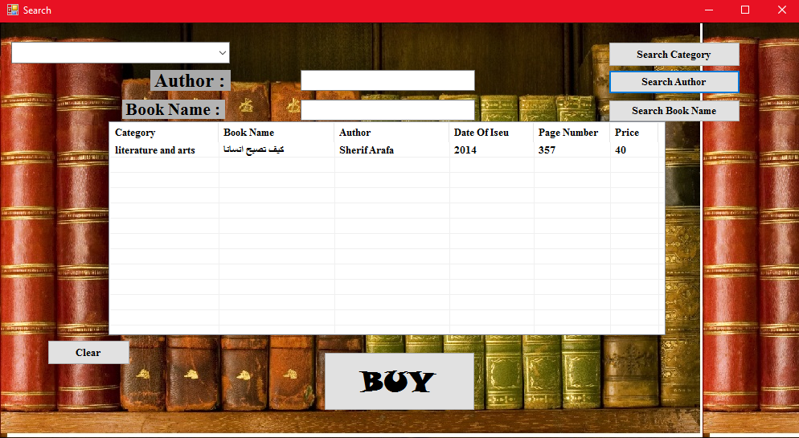
Search Author Button
When We Click On Search Author Button, Search About Books By Author .

Slide 13
Search Book Name Button
When We Click On Search Book Name Button, Search About Books By Book Name .

Slide 14
Clear Button
When We Click On Clear Button, Clear List View.

Slide 15
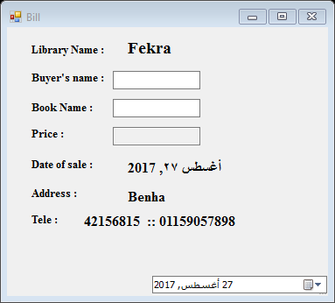
Buy Button
When We Click On Buy Button, Move Us To Bill Form .

Slide 16
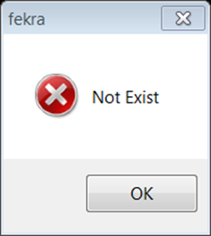
MessageBox
If You Search For Book and Not Exist Appear This MessageBox.

Slide 17
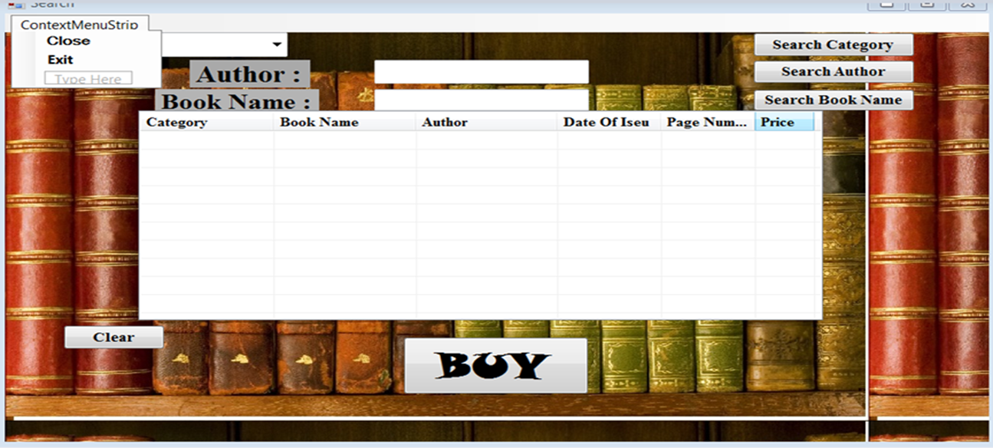
ContextMenuStrip
Search Form Contain To ContextMenuStrip.

Slide 18

contents

Slide 19
Bill

Slide 20
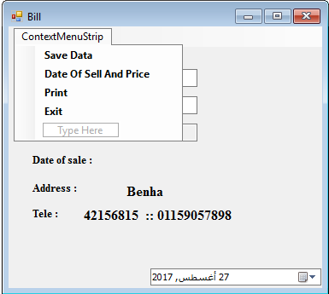
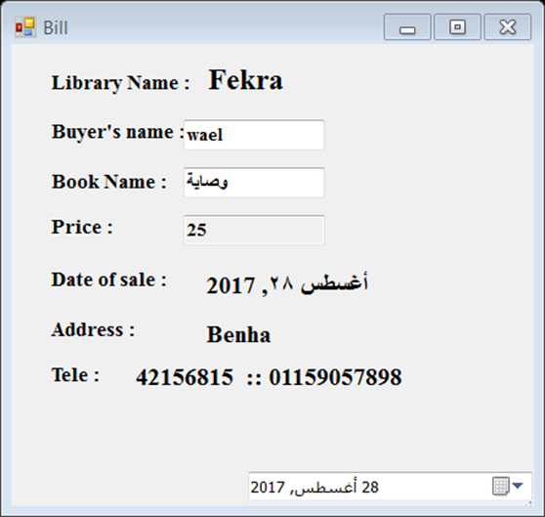
Date Of Sell And Price
When We Click On Date Of Sell And Price Button, Add currently Date In Bill Form and price of book.

Slide 21
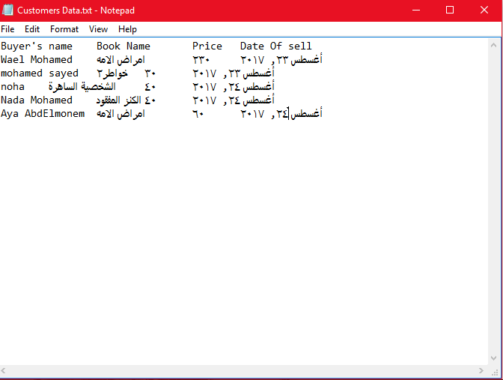
Save Data Button
When We Click On Save Data Button, Add data Of Customers On File .

Slide 22
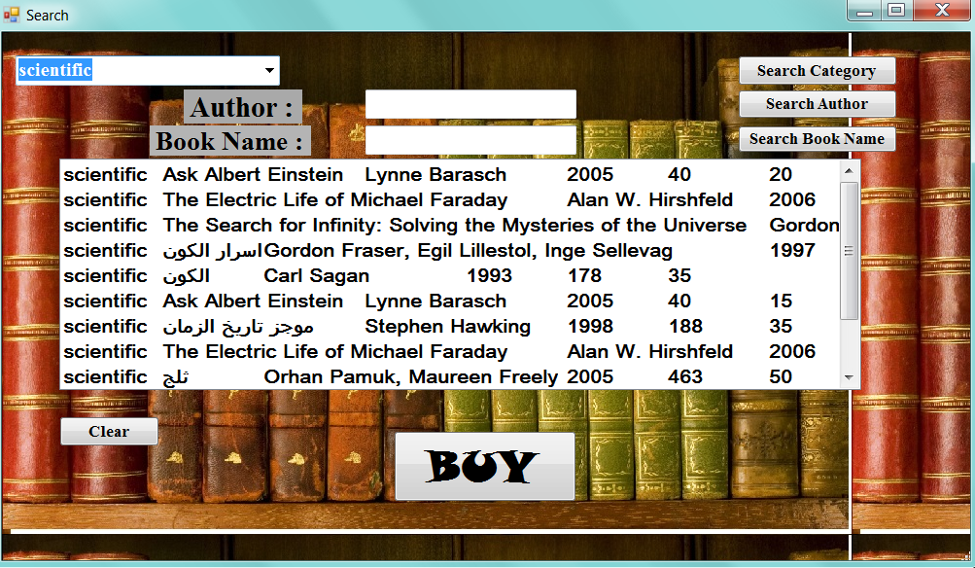
Print Or Close Button
Print Button will Close The Bill Form .

Slide 23
Exit Button
This Button will Exit The Program

Slide 24
contents
Form4:

Slide 25
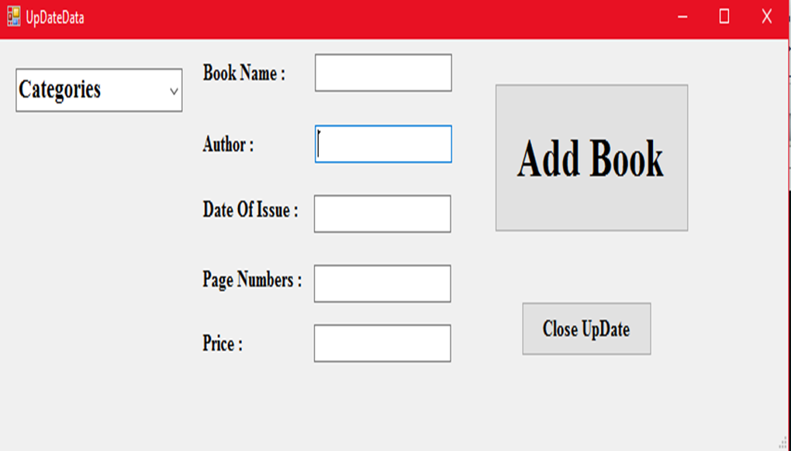
Update Data

Slide 26
Add Button
When We Click On Add Button, Add New Book On File .

Slide 27
Close Update Button
This Button will Close Update Form.

Slide 28
Fekra
Wael Mohamed Abd Elmoaty
Wasem Edwer Pasta
Nada Mohamed Mohamed Abdo
Noha Emad Sayed
Hesham Aymen Elsayed
Lab : 12

Slide 29


Any Questions ??!
fekra

